Slide 1





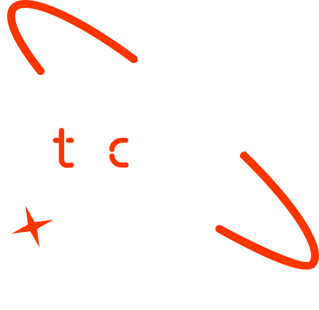

Predicting Malnutrition Risk Factors in Children from Low-Income Developing Countries Using Machine Learning
MAHA
Date

Slide 2
Remove this page before uploading the presentation to your presentation!
How to use this template
Download the file.
Change the name into "Name_Surname_Groupnumber_Final_Presentation"​.
Do not move the text boxes, keep your text and visuals inside the boxes​.
Do not change the colors and font type​.
If you need to change the font size make it consistent and don't use different sizes in one page (biggest 28, smallest 20). Titles always should be 33,5.
You can duplicate a page if you need more than one pages​.
Add high quality pictures and their sources. Keep it inside the boxes.

Slide 3

Outline
Concept note and implementation plan
Background
Objectives
SDG Relation
Data
Data Collection
Exploratory Data Analysis et Feature Engineering
Model
Model Selection and Training
Model Evaluation and Hyperparameter Tuning
Model Refinement and Testing
Results
Evaluation Results
Deployment
Future Work

Slide 4
Concept note and Implementation Plan
Notes:
FTs like precision agriculture, remote sensing & AI-powered forming equipment can help increase agricultural productivity in LDCs. This can improve fiid security & contribute to the achievement of SDG 2 (Zero Hunger).

Slide 5
Concept note and Implementation Plan
This project focuses on predicting malnutrition risk factors: stunting, wasting, and healthy weight among children in low-income developing countries using machine learning techniques.
The goal is to identify at-risk children early, enabling timely interventions to improve child health.
Notes:
FTs like precision agriculture, remote sensing & AI-powered forming equipment can help increase agricultural productivity in LDCs. This can improve fiid security & contribute to the achievement of SDG 2 (Zero Hunger).

Slide 6
Background
Malnutrition remains a significant issue in developing countries, contributing to high child mortality rates.
Predictive models can help detect at-risk children and allocate resources effectively.
Notes:
FTs like precision agriculture, remote sensing & AI-powered forming equipment can help increase agricultural productivity in LDCs. This can improve fiid security & contribute to the achievement of SDG 2 (Zero Hunger).

Slide 7
Objectives
Predict malnutrition risk factors using machine learning.
Identify the most significant predictors of malnutrition.
Deploy an efficient model for real-time risk assessment.
Notes:
FTs like precision agriculture, remote sensing & AI-powered forming equipment can help increase agricultural productivity in LDCs. This can improve fiid security & contribute to the achievement of SDG 2 (Zero Hunger).

Slide 8

SDG Relation
This project directly supports SDG 2: Zero Hunger by addressing malnutrition.
Notes:
FTs like precision agriculture, remote sensing & AI-powered forming equipment can help increase agricultural productivity in LDCs. This can improve fiid security & contribute to the achievement of SDG 2 (Zero Hunger).

Slide 9

SDG Relation
It also supports SDG 3: Good Health and Well-being by improving child health outcomes.
Notes:
FTs like precision agriculture, remote sensing & AI-powered forming equipment can help increase agricultural productivity in LDCs. This can improve fiid security & contribute to the achievement of SDG 2 (Zero Hunger).

Slide 10
Data
Notes:
FTs like precision agriculture, remote sensing & AI-powered forming equipment can help increase agricultural productivity in LDCs. This can improve fiid security & contribute to the achievement of SDG 2 (Zero Hunger).

Slide 11
Data Collection
We used the "Multivariate Random Forest Prediction of Poverty and Malnutrition Prevalence" dataset from Kaggle, which contains social and environmental indicators from 11 countries.
The data was derived from research by Chris Browne and colleagues. It includes a wide range of factors influencing poverty and malnutrition, encoded into numerical values for model training.
Notes:
FTs like precision agriculture, remote sensing & AI-powered forming equipment can help increase agricultural productivity in LDCs. This can improve fiid security & contribute to the achievement of SDG 2 (Zero Hunger).

Slide 12
DHS malnutrition and asset poverty data
Asset Poverty: Households in the lowest wealth quintile, with an asset index score ≤ -0.9080 (FTF 2018).
Child Stunting: Children under 5 whose height-for-age is more than 2 standard deviations below the WHO median.
Child Wasting: Children under 5 whose weight-for-height is more than 2 standard deviations below the WHO median.
Healthy Weight: Children under 5 whose weight-for-height is within 2 standard deviations from the WHO median.
Underweight Women: Women aged 15-49 with a BMI less than 18.5.
Notes:
FTs like precision agriculture, remote sensing & AI-powered forming equipment can help increase agricultural productivity in LDCs. This can improve fiid security & contribute to the achievement of SDG 2 (Zero Hunger).

Slide 13
2. Physical geography covariates
Travel time to nearest city (population 500,000+), based on IFPRI’s global market accessibility models.
Percent tree cover at 1 km resolution, produced by [28].
Pasture coverage from Ramankutty et al.’s data (2000), at ~10 km resolution.
Altitude data from NASA’s Shuttle Radar Topography Mission.
Slope data, calculated by IFPRI as the gradient steepness.
Notes:
FTs like precision agriculture, remote sensing & AI-powered forming equipment can help increase agricultural productivity in LDCs. This can improve fiid security & contribute to the achievement of SDG 2 (Zero Hunger).

Slide 14
Other data
3. Food price data
4. Solar-induced chlorophyll fluorescence data (SIF)
5. Land surface temperature data
6. Precipitation data (CHIRPS)
Notes:
FTs like precision agriculture, remote sensing & AI-powered forming equipment can help increase agricultural productivity in LDCs. This can improve fiid security & contribute to the achievement of SDG 2 (Zero Hunger).

Slide 15
Exploratory Data Analysis and Feature Engineering
Handled missing values.
Handled zero values using KNN imputation.
Visualized data distributions to understand patterns.
Applied transformations and checked correlations to select important features.
Notes:
FTs like precision agriculture, remote sensing & AI-powered forming equipment can help increase agricultural productivity in LDCs. This can improve fiid security & contribute to the achievement of SDG 2 (Zero Hunger).

Slide 16
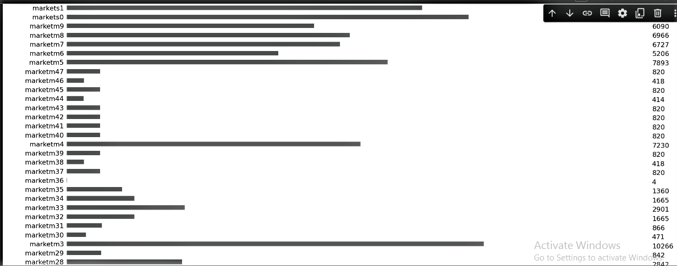
Handled missing values
Notes:
FTs like precision agriculture, remote sensing & AI-powered forming equipment can help increase agricultural productivity in LDCs. This can improve fiid security & contribute to the achievement of SDG 2 (Zero Hunger).

Slide 17
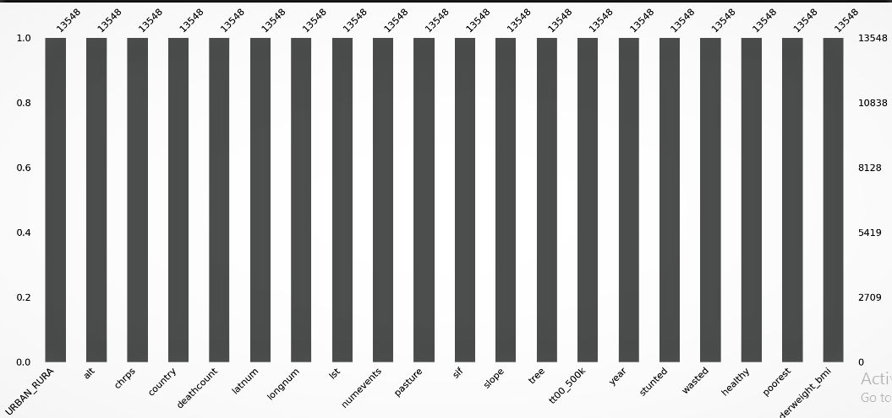
Handled missing values
Notes:
FTs like precision agriculture, remote sensing & AI-powered forming equipment can help increase agricultural productivity in LDCs. This can improve fiid security & contribute to the achievement of SDG 2 (Zero Hunger).

Slide 18
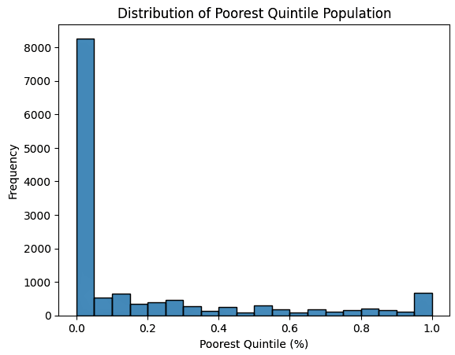
2. Handled zero values using KNN imputation
Notes:
FTs like precision agriculture, remote sensing & AI-powered forming equipment can help increase agricultural productivity in LDCs. This can improve fiid security & contribute to the achievement of SDG 2 (Zero Hunger).

Slide 19
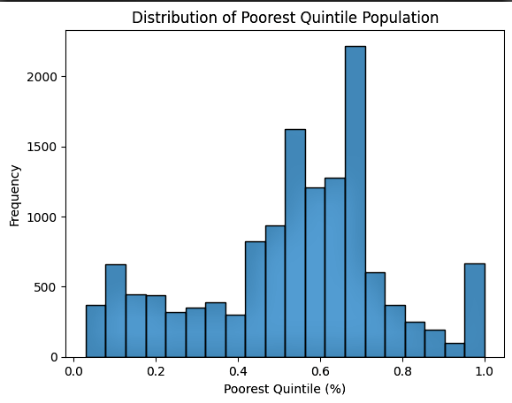
2. Handled zero values using KNN imputation
Notes:
FTs like precision agriculture, remote sensing & AI-powered forming equipment can help increase agricultural productivity in LDCs. This can improve fiid security & contribute to the achievement of SDG 2 (Zero Hunger).

Slide 20
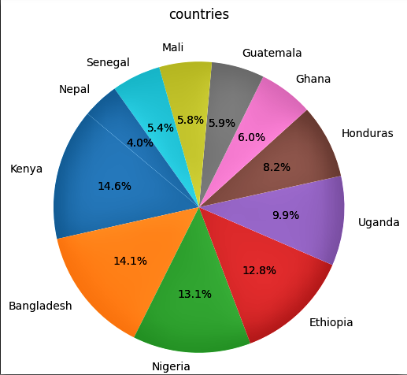
3. Visualized data distributions to understand patterns
Notes:
FTs like precision agriculture, remote sensing & AI-powered forming equipment can help increase agricultural productivity in LDCs. This can improve fiid security & contribute to the achievement of SDG 2 (Zero Hunger).

Slide 21
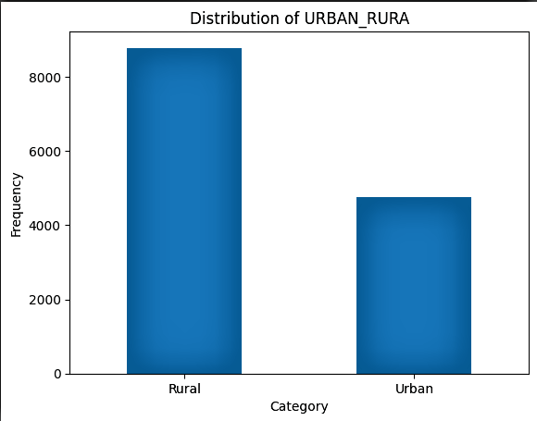
3. Visualized data distributions to understand patterns
Notes:
FTs like precision agriculture, remote sensing & AI-powered forming equipment can help increase agricultural productivity in LDCs. This can improve fiid security & contribute to the achievement of SDG 2 (Zero Hunger).

Slide 22
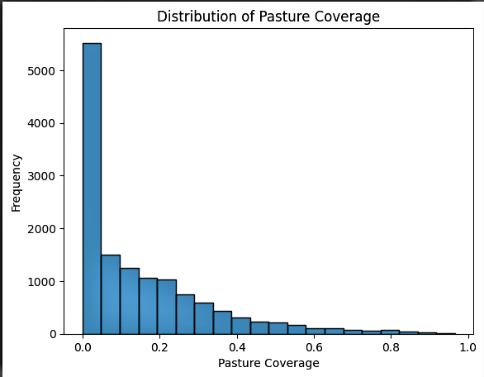
4. Applied transformations and checked correlations to select important features
Notes:
FTs like precision agriculture, remote sensing & AI-powered forming equipment can help increase agricultural productivity in LDCs. This can improve fiid security & contribute to the achievement of SDG 2 (Zero Hunger).

Slide 23
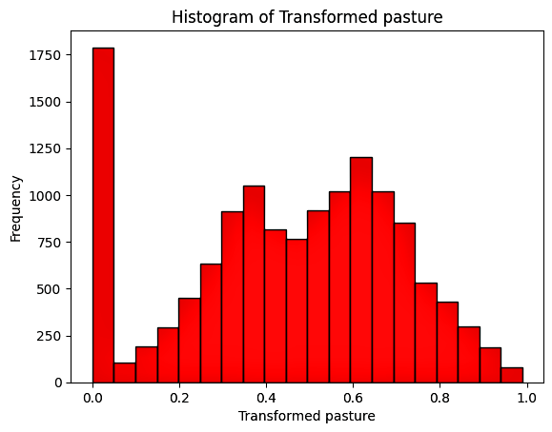
4. Applied transformations and checked correlations to select important features
Notes:
FTs like precision agriculture, remote sensing & AI-powered forming equipment can help increase agricultural productivity in LDCs. This can improve fiid security & contribute to the achievement of SDG 2 (Zero Hunger).

Slide 24
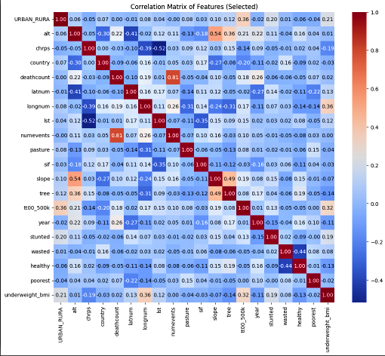
4. Applied transformations and checked correlations to select important features
Notes:
FTs like precision agriculture, remote sensing & AI-powered forming equipment can help increase agricultural productivity in LDCs. This can improve fiid security & contribute to the achievement of SDG 2 (Zero Hunger).

Slide 25
Model
Notes:
FTs like precision agriculture, remote sensing & AI-powered forming equipment can help increase agricultural productivity in LDCs. This can improve fiid security & contribute to the achievement of SDG 2 (Zero Hunger).

Slide 26
Model
We tested several models:
Multivariate Random Forest (MRF)
Independent Random Forest (RF)
Neural Network
XGBoost
Notes:
FTs like precision agriculture, remote sensing & AI-powered forming equipment can help increase agricultural productivity in LDCs. This can improve fiid security & contribute to the achievement of SDG 2 (Zero Hunger).

Slide 27
Model Selection and Training
Multivariate Random Forest (MRF) was chosen as it outperformed more complex models like Neural Networks (NN) in terms of efficiency and accuracy, while being less costly to train.
Notes:
FTs like precision agriculture, remote sensing & AI-powered forming equipment can help increase agricultural productivity in LDCs. This can improve fiid security & contribute to the achievement of SDG 2 (Zero Hunger).

Slide 28
Model Evaluation and Hyperparameter Tuning
We evaluated model performance using standard metrics.
Fine-tuned hyperparameters to optimize MRF for best results.
Notes:
FTs like precision agriculture, remote sensing & AI-powered forming equipment can help increase agricultural productivity in LDCs. This can improve fiid security & contribute to the achievement of SDG 2 (Zero Hunger).

Slide 29
Model Refinement and Testing
Hyperparameter tuning: Optimized Random Forest using grid search (n_estimators=300, max_depth=10, min_samples_split=5).
Cross-validation: Applied 5-fold cross-validation to ensure robustness.
Regularization: Considered L2 regularization for neural networks to avoid overfitting.
Feature selection: Removed highly correlated features and selected the top 9 features most related to the target.
Notes:
FTs like precision agriculture, remote sensing & AI-powered forming equipment can help increase agricultural productivity in LDCs. This can improve fiid security & contribute to the achievement of SDG 2 (Zero Hunger).

Slide 30
Results
Notes:
FTs like precision agriculture, remote sensing & AI-powered forming equipment can help increase agricultural productivity in LDCs. This can improve fiid security & contribute to the achievement of SDG 2 (Zero Hunger).

Slide 31
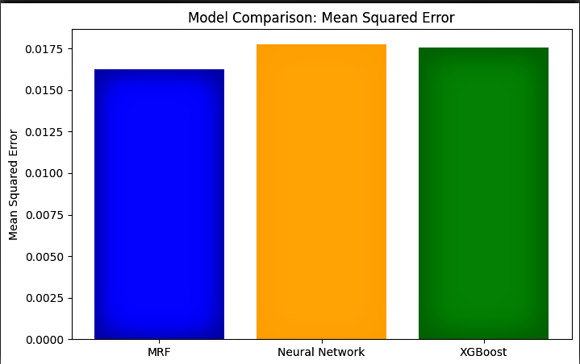
Evaluation Results | MSE
Notes:
FTs like precision agriculture, remote sensing & AI-powered forming equipment can help increase agricultural productivity in LDCs. This can improve fiid security & contribute to the achievement of SDG 2 (Zero Hunger).

Slide 32
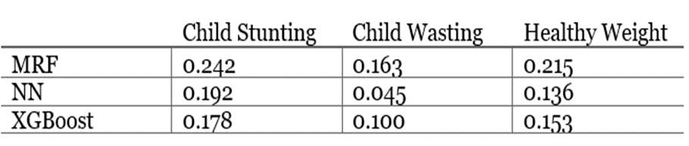
Evaluation Results | R^2
Notes:
FTs like precision agriculture, remote sensing & AI-powered forming equipment can help increase agricultural productivity in LDCs. This can improve fiid security & contribute to the achievement of SDG 2 (Zero Hunger).

Slide 33
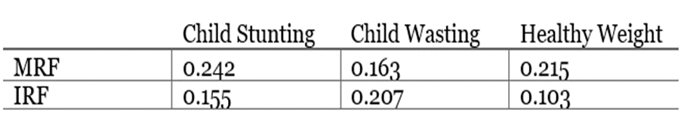
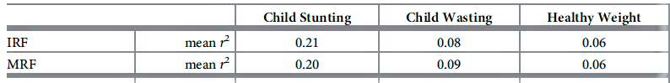
Evaluation Results | R^2 Comparison
Notes:
FTs like precision agriculture, remote sensing & AI-powered forming equipment can help increase agricultural productivity in LDCs. This can improve fiid security & contribute to the achievement of SDG 2 (Zero Hunger).

Slide 34
Evaluation Results
Results were visualized using parity plots and residual plots, demonstrating good fit and predictive accuracy.
Notes:
FTs like precision agriculture, remote sensing & AI-powered forming equipment can help increase agricultural productivity in LDCs. This can improve fiid security & contribute to the achievement of SDG 2 (Zero Hunger).

Slide 35
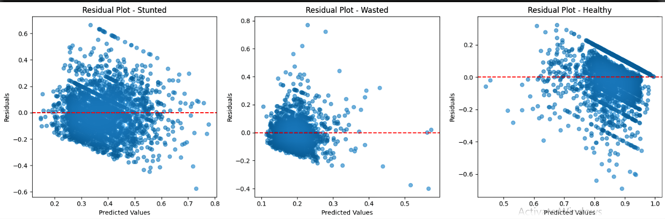
Evaluation Results | Residual Plot
Notes:
FTs like precision agriculture, remote sensing & AI-powered forming equipment can help increase agricultural productivity in LDCs. This can improve fiid security & contribute to the achievement of SDG 2 (Zero Hunger).

Slide 36
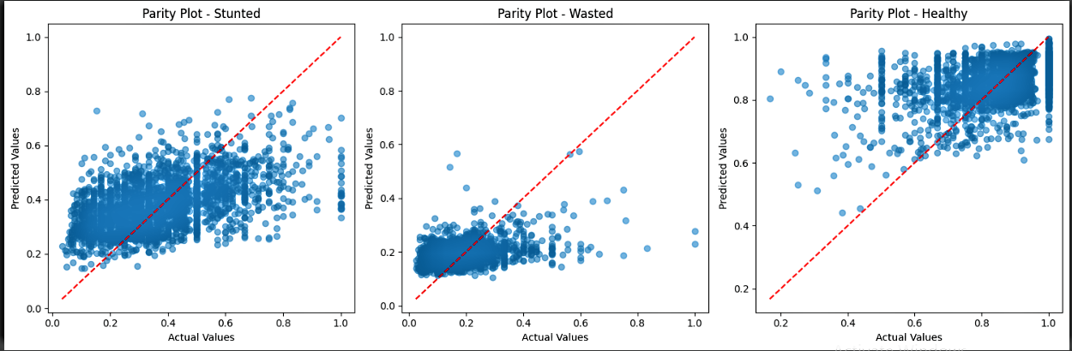
Evaluation Results | Parity Plot
Notes:
FTs like precision agriculture, remote sensing & AI-powered forming equipment can help increase agricultural productivity in LDCs. This can improve fiid security & contribute to the achievement of SDG 2 (Zero Hunger).

Slide 37
Deployment
The deployment phase focuses on preparing the trained machine learning model for real-world or production use.
The is to ensure that the model is reliably accessible to end-user objectives or other systems while maintaining both performance and security.
Notes:
FTs like precision agriculture, remote sensing & AI-powered forming equipment can help increase agricultural productivity in LDCs. This can improve fiid security & contribute to the achievement of SDG 2 (Zero Hunger).

Slide 38
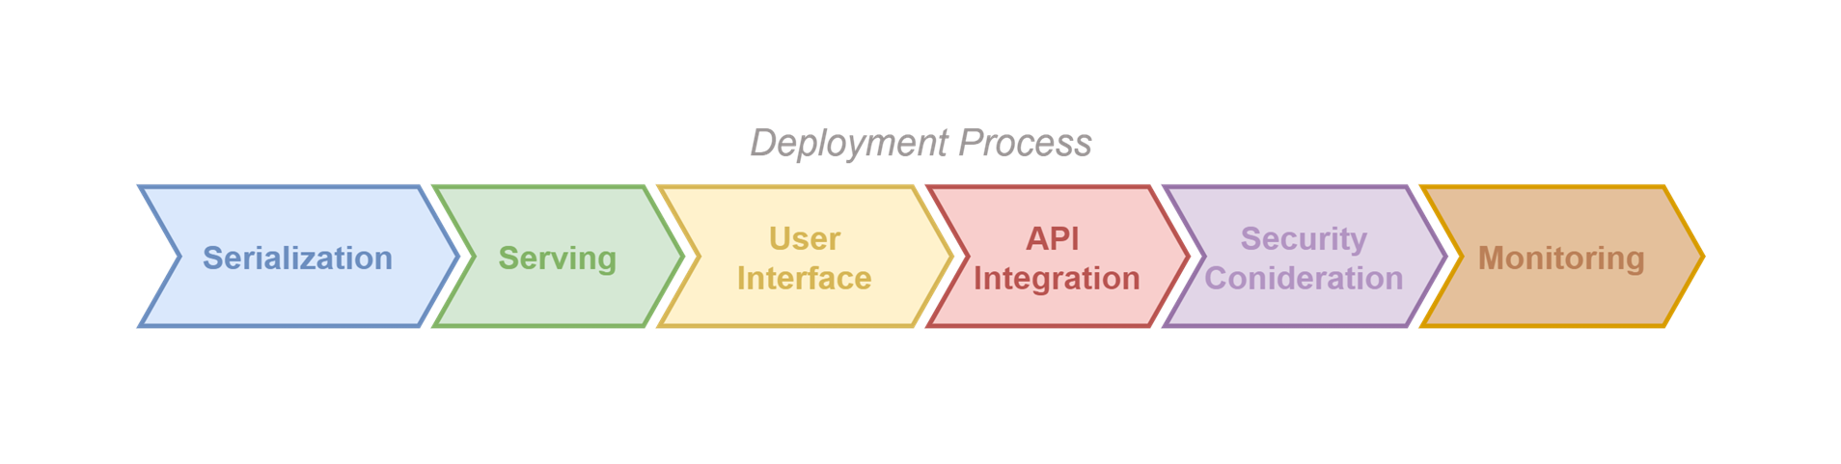
Deployment
Notes:
FTs like precision agriculture, remote sensing & AI-powered forming equipment can help increase agricultural productivity in LDCs. This can improve fiid security & contribute to the achievement of SDG 2 (Zero Hunger).

Slide 39
Deployment | Demo
Click here
Notes:
FTs like precision agriculture, remote sensing & AI-powered forming equipment can help increase agricultural productivity in LDCs. This can improve fiid security & contribute to the achievement of SDG 2 (Zero Hunger).

Slide 40
Future Work
The future work includes extending the model to incorporate additional risk factors and implementing it in mobile and web applications for field use.
Collaboration with local governments, NGOs, and community members will be pursued to better understand their needs, integrate more data features, and explore relationships between those features.
Notes:
FTs like precision agriculture, remote sensing & AI-powered forming equipment can help increase agricultural productivity in LDCs. This can improve fiid security & contribute to the achievement of SDG 2 (Zero Hunger).

Slide 41
References
Browne, C., Matteson, D. S., McBride, L., et al. (2017) Multivariate random forest prediction of poverty and malnutrition prevalence. Journal of Applied Econometrics Link .
Notes:
FTs like precision agriculture, remote sensing & AI-powered forming equipment can help increase agricultural productivity in LDCs. This can improve fiid security & contribute to the achievement of SDG 2 (Zero Hunger).

Slide 42


Thank you!

